Slide 1
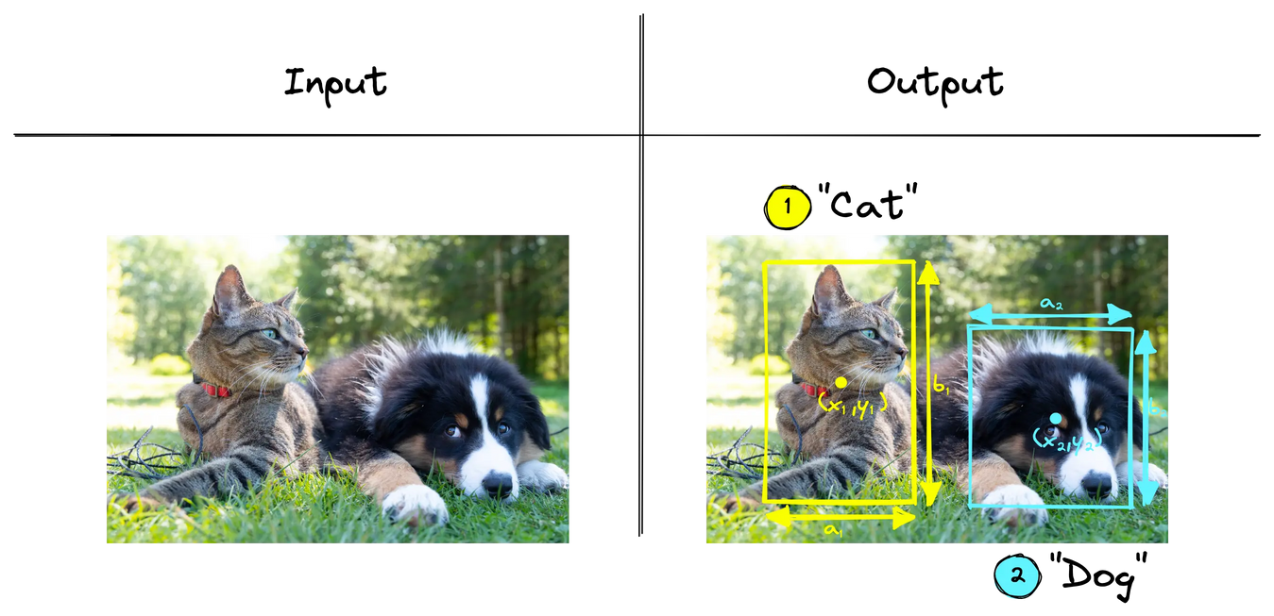

Zero-shot Object Detection
USING GDINO
Project Lead: Priyanka Singh

Slide 2
BRIDGING THE GAP IN OBJECT DETECTION
Problem: Fixed-class detectors can’t handle unseen categories.
Solution: Zero-shot detection finds objects from text prompts without retraining.
Model: Grounding DINO, a state-of-the-art open-set detector combining vision + language.

Slide 3
KEY PROJECT GOALS
Implement a full end-to-end zero-shot detection pipeline.
Evaluate the model's ability to detect novel objects.
Analyze the impact of different prompt formulations (e.g., synonyms, detailed descriptions).
Visualize and analyze model performance, including failure modes.

Slide 4
THE PROJECT Pipeline
Model: Grounding DINO (Hugging Face)
Dataset: 60 COCO 2017 val images
Pipeline:
Prep: Select images + prompts
Inference: Zero-shot detection with prompt strategies
Eval: Visual & mAP analysis
Analysis: Compare strategies, assess sensitivity

Slide 5
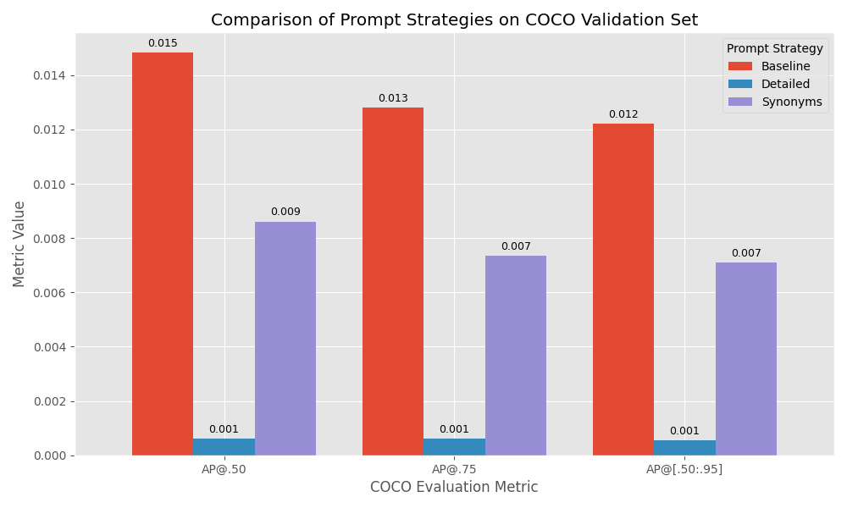
EVALUATION METRICS (MAP)
mAP was modest, as expected in zero-shot.
Key finding: Better AP@.50 → good object ID, weaker box precision.

Slide 6
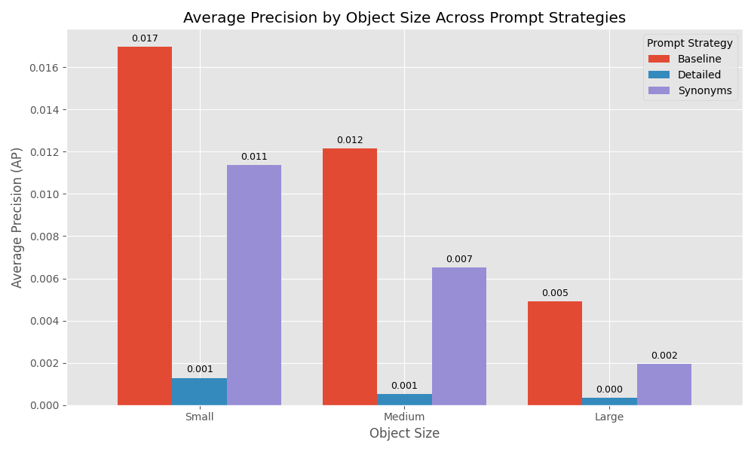
PERFORMANCE BY OBJECT SIZE
Best on small objects with baseline prompts (AP: 0.017).
Weaker on medium, poorest on large objects.
Failures: struggles with occlusion, tough angles, and generic prompts.

Slide 7
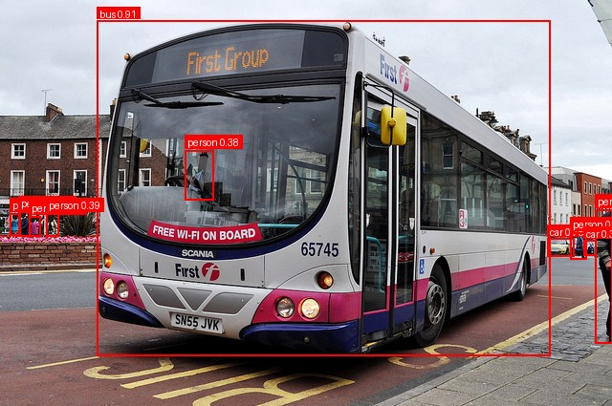
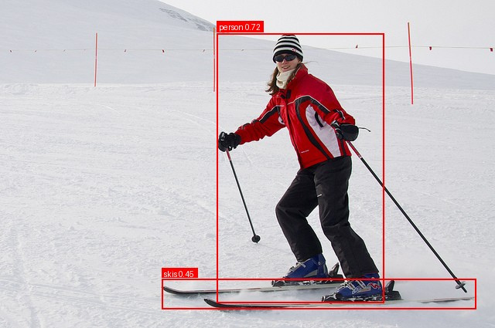
BASELINE PROMPT

Slide 8
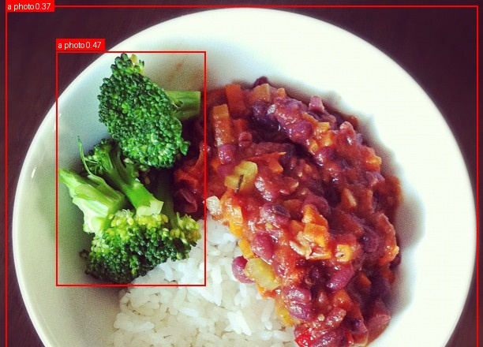
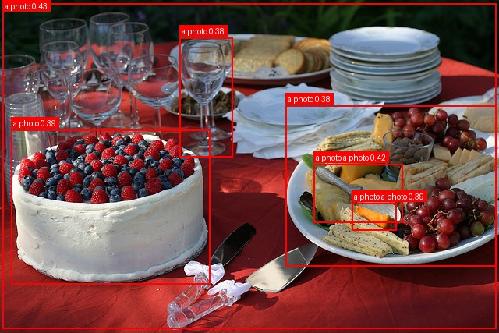
DETAILED PROMPT

Slide 9
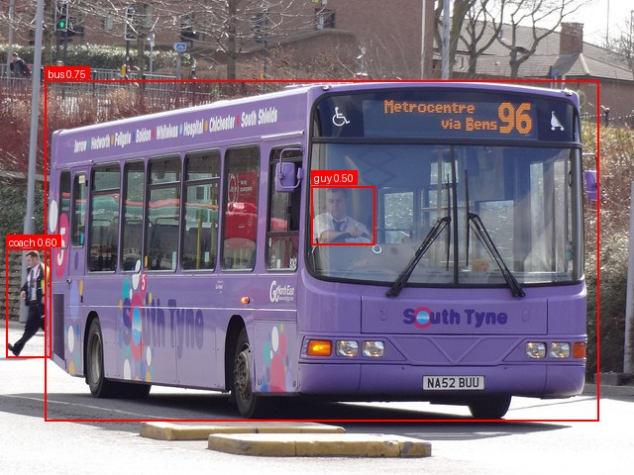
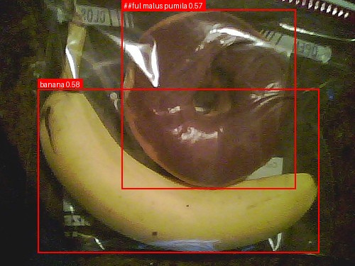
SYNONYMS PROMPT

Slide 10
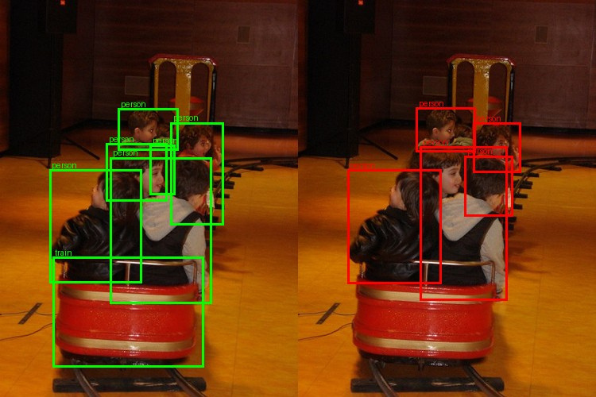
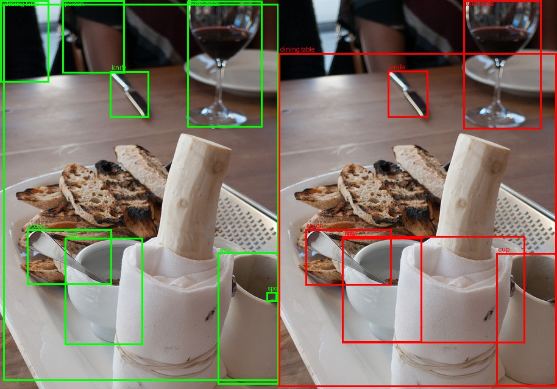
GROUND TRUTH VS PREDICTION

Slide 11

CONCLUSION & FUTURE WORK
Key Takeaways:
Grounding DINO works well for zero-shot object detection.
Prompt wording matters — clear and minimal > context-heavy descriptive prompts.
Detailed prompts hurt performance when they add scene context that isn’t visible.
Next Steps:
Scale to larger, diverse dataset.
Try alternatives (e.g., YOLO-World).

Slide 12
Thank you!

